Slide 1
Financial analysis for Disney using python
Team Members: I-Peng Liu, Rushi Thakar, Fangning Li, Hao Gong

Slide 2
AGENDA
Background
Basic financial analysis for Disney and its relevant companies
Regression Analysis
Simple Moving Average Analysis – Trading strategy
Conclusion

Slide 3
Business Problem and study process
Challenged with the chance to evaluate and understand the business environment and opportunities Disney facing. The issue is to identify where Disney have the opportunities to facilitate the future growth based on the analysis of the historical stock price.
Basic Financial Analysis
Regression Analysis
Trading Strategy
Study and Analysis Process

Slide 4
Basic financial analysis for Disney - framework
Problems:
How is the performance of Disney’s stock price from 2010 to 2017?
What’s the correlations among Disney and other peer companies?
Methodology:
Basic financial analysis and advanced time series analysis - Pandas, Matplotlib, and Numpy
Data visualizations based on four sectors (Disney’s Concentrations)
Studio entertainment
Parks and resort
Consumer products & Interactive media
Media Network
Challenges:
Data collection and data cleaning
Statistical analysis

Slide 5
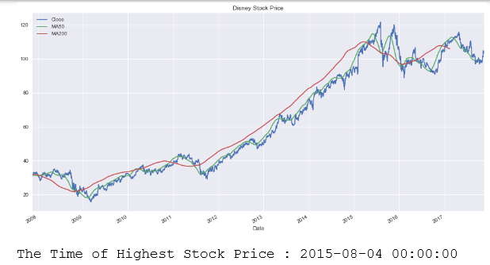
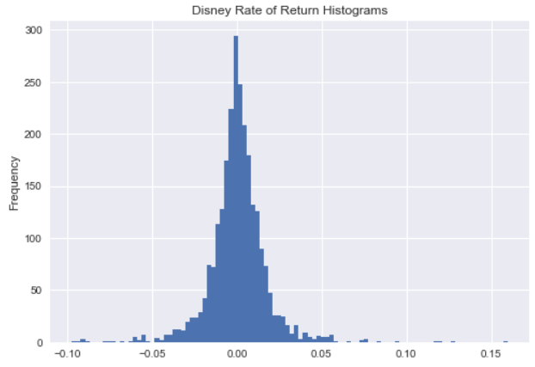
Basic financial analysis for Disney - findings
Basic stock performance for Disney
Historical stock price of Disney with moving averages
Daily rate of return histogram for Disney

Slide 6
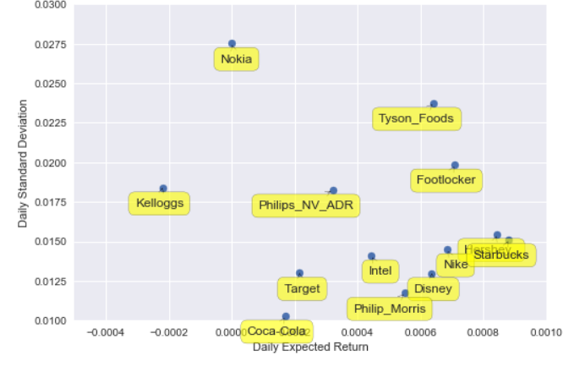
Basic financial analysis for Disney - findings
Daily standard deviation vs expected return
Disney
low standard deviation
Relatively high return

Slide 7
Regression analysis - Framework
Problem:
What is the day to day co-relation of Disney and Peer company’s stock price?
How can you represent the relationship between them?
Methodology:
Regression Analysis based on same four major company’s sector
Challenges:
Data cleaning and data organization

Slide 8
Regression analysis – findings and results
Studio:
= 151.6437 + 0.1542 AMCX - 3.8416 CMCSA + 0.7569 FOXA – 0.685 SNE – 0.1221 TWX
R-Square Value: 0.978
Park:
= 53.990 + 0.4724 AAL + 0.6922 FUN - 0.3044 MCD – 0.5686 SEAS + 0.6420 SIX
R-Square value: 0.8330
Media:
= 15.8563 + 1.2551 BT + 0.8169 CBS – 0.4113 DISCA + 0.1571 GLOB + 0.1070 NFLX
R-Square: 0.996
Interactive Media:
= -18.2753 – 0.0343 AMZN + 1.0024 KO + 0.3409 EA + 0.5853FL + 0.2581 HSY – 0.4213 K + 0.4175 NKE + 0.7404 PHG
R=Square: 0.997
Improvement: There is still complacency of improvement in this model. This analysis is only done based on sector-wise best fit companies’ stock price.

Slide 9
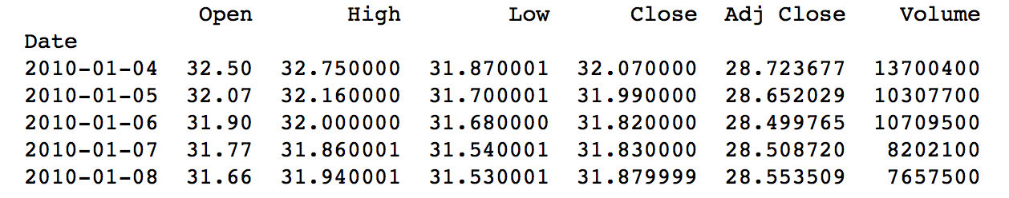
Simple Moving Average Analysis - Framework
Problem:
When to enter or exit the stock market to maximize the investment?
Methodology:
Use moving Average Crossover Strategy to identify ”Go long” or “Go short” signals
Conduct backtesting to test the performance and risk of trading strategy on historical stock price data
Method:
Fetch Disney’s historical stock price (2010.1.1-2017.10.24) from Yahoo Finance

Slide 10
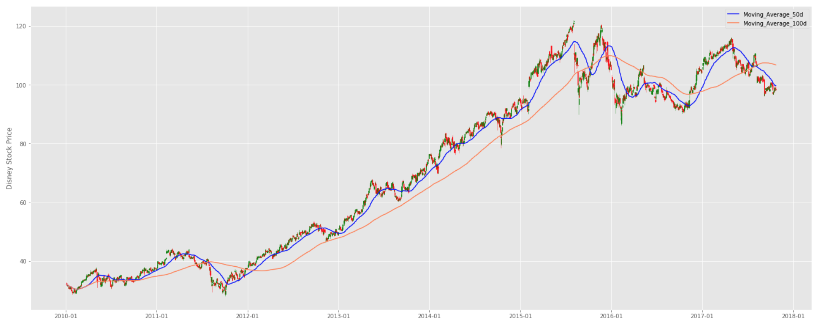
Plotted the stock price in candlestick chart
Defined two lookback periods:
a 50-day short window
a 100-day long window
Created two moving average filters using Simple Moving Average (SMA) to calculate the mean stock price on the Disney’s “Ajusted Closing Price”

Slide 11
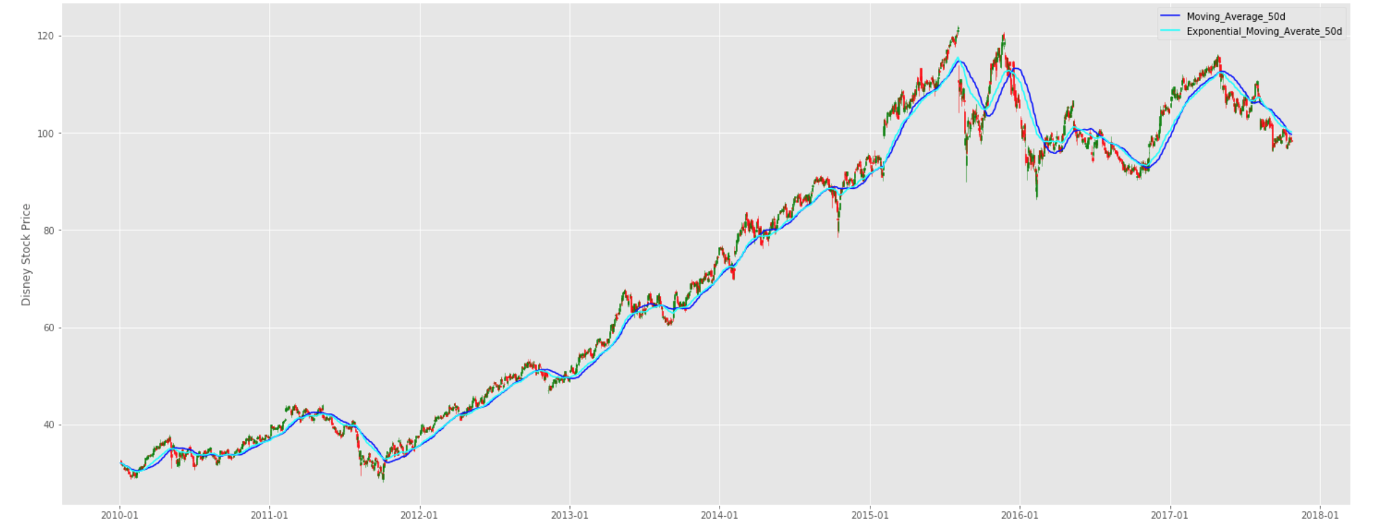
Created two moving average filters using Exponential Moving Average (EMA)
Compare SMA & EMA
SMA timeseries lag the original price timeseries, which means that changes in the trend are only seen
with a delay (lag) of L days, which can significantly affect our strategy
EMA can help reduce the lag because it puts more weights on more recent observations

Slide 12
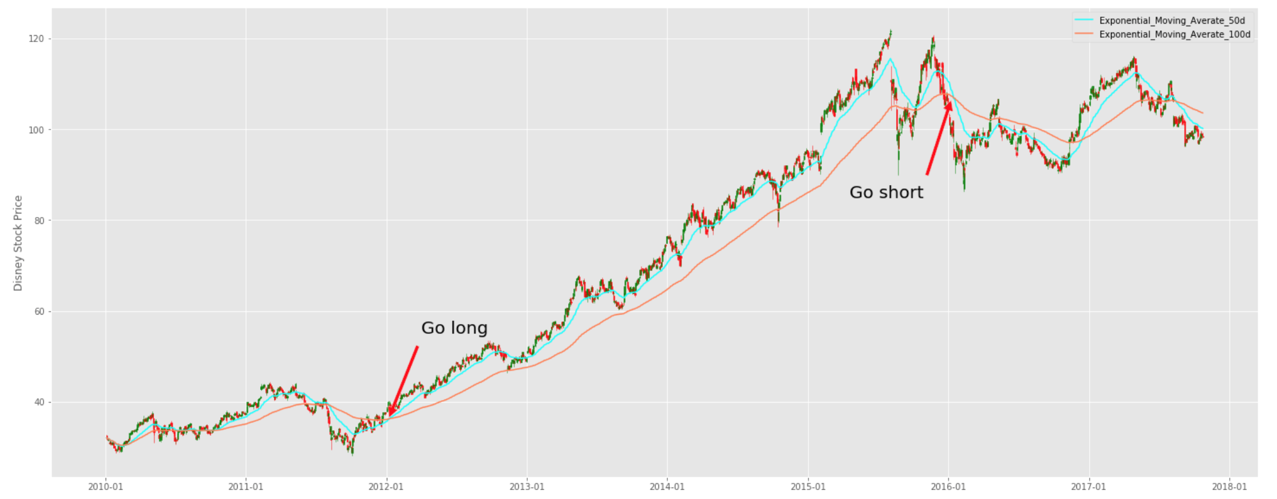
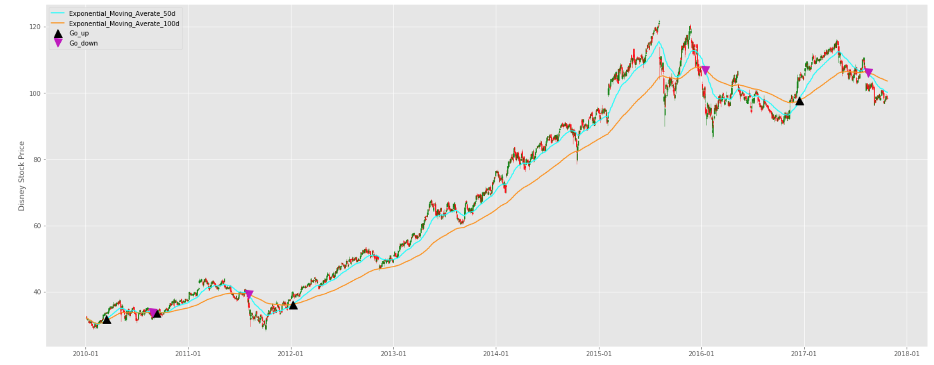
Identify the “Enter/ Go long” or “Exit/ Go short” signals:
If the short moving average exceed the long moving average then it’s a signal to go long or buy in the stock, because this signals marks a stock price will constantly go up.
If the long moving average exceeds the short moving average then it’s a signal to go short or exit the market.

Slide 13
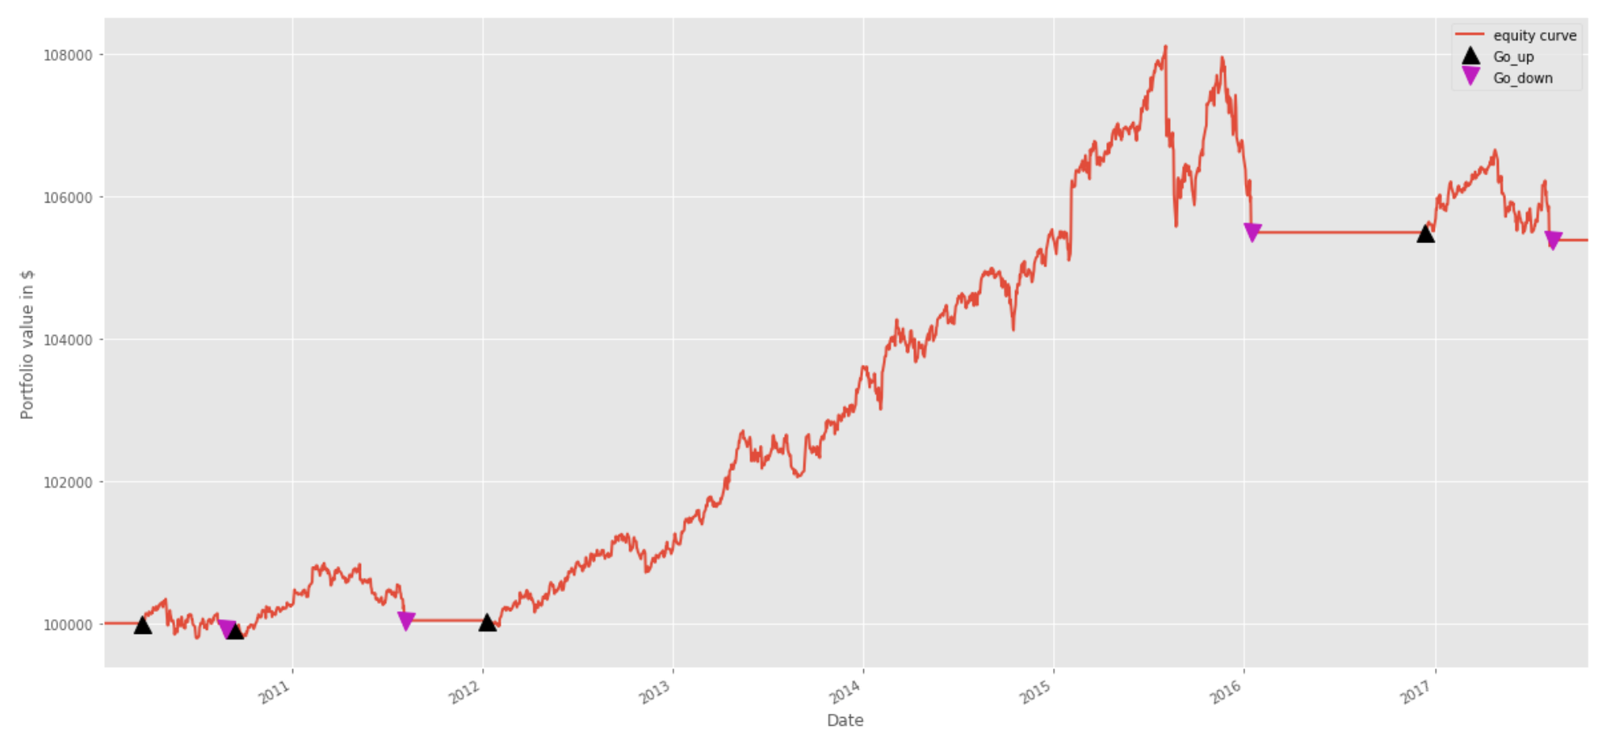
Backtesting: to test the performance and risk of trading strategy on historical data
Set $100000 initial_capital, bought in 100 shares at every ”Go long” signal
Portfolio [‘holdings’] = # of stock * stock price[‘Adj Close’]
Cash = initial_capital – Portfolio [‘holdings’];
Portfolio[‘total’] = Cash + portfolio['holdings']
Equity Curve:
Profit: (105500 – 100000)/100000 = 5.5%

Slide 14
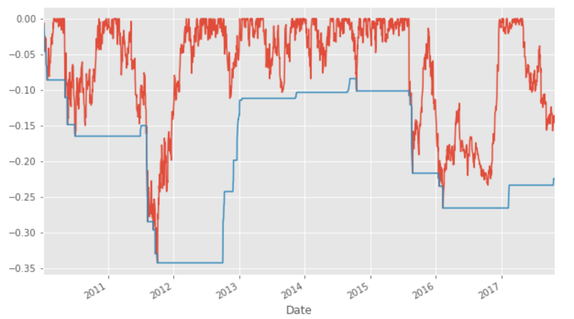
Maximum Drawdown
Risk Measurement:
Sharpe Ratio: 0.584
Improvements:
Use complex algorithms, like KMeans, Classification to improve trading model
Multi-symbol portfolios, by adding more columns to a pandas DataFrame
Realistic handling of transaction costs – fees, slippage and possible market impact

Slide 15
Thank you

